Slide 1

Fear and Loathing for Science:
Hallucinogenic Plasticity
Kathleen Leeper

Slide 2
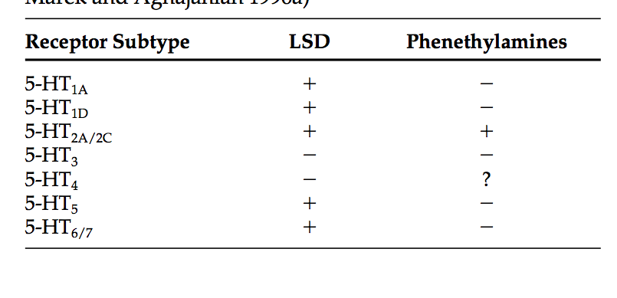
LSD and Phenethylamines affinity for 5-HT Receptor Subtypes
(Glennon 1990; Marek and Aghajanian 1996a)

Slide 3
Things you might learn about
Cultural and historical hallucinogens
Dissociatives & deliriants
Classical hallucinogens: Perception & Structure
5-HT Receptors and ligand signalling
Mechanisms & agonist interactions across the brain
Hallucinogenic gene expression changes
Cellular changes

Slide 4
Cultural and historical hallucinogens
Huichol, Tarahumara, numerous other peoples, Mexico and the American Southwest
peyote
Aztec, Mexico
morning glory seeds
Native tribes of the northwest Amazon, Upper Orinoco, Venezuela and Brazil
yopo
Ebene
Ayahuasca-caapi-yage
“violently hallucinogenic”
San Pedro curative cults, Northern Andes, Peru
San Pedro cactus
Siberia
fly agaric
Medieval Europe (aka witches)
belladonna
henbane
mandrake
datura
Notes:
Peyote = mescaline
Morning glory seeds =LSA
Yopo beans from yopo trees = DMT
Ebene = nutmeg tree
Ayahuasca = DMT
San pedro – mescaline rich cactus
Belladonna, henbane = deliriants
Lithuania--Amanita muscaria taken at wedding feasts, in which mushrooms were mixed with vodka

Slide 5
Dissociatives & deliriants
Dissociatives
analgesia, amnesia and catalepsy
sense of detachment
derealization, depersonalization,
CNS depressant effects/risks
NMDA receptor antagonists
ketamine, phencyclidine (PCP), dextromethorphan (DXM), nitrous oxide, and salvia
Deliriants
state of delirium similar to fevers with confusion, inability to control actions
toxic, overdose risk, other unpleasant side effects
disrupts acetylcholine activity
Belladonna, datura, henbane, mandrake, nutmeg
  Benadryl and Dramamine in large doses
  Uncured tobacco--intoxicatingly high levels of nicotine
Notes:
Disassociatives
→ similar risks as opioids, which can slow breathing or heart rate to levels resulting in death
Deliriants
→ No one likes them
→ User reports – 'would not repeat'

Slide 6
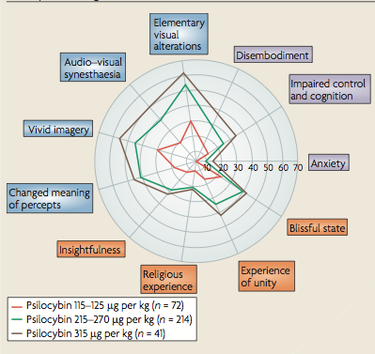
Classical hallucinogens: Perception
Hollister (1968):
changes in thought, mood, and perception with little memory or intellectual impairment
little stupor, narcosis, or excessive stimulation
minimal autonomic side effects
nonaddicting
The scales indicate the percentage scored of the maximum score.
(Vollenweider and Kometer, 2010)
Notes:
altered states of consciousness reliably measured by five-dimensional altered states of consciousness rating scale.
experiential phenomena are otherwise rarely reported except in dreams, contemplative or religious exaltation and acute psychoses

Slide 7
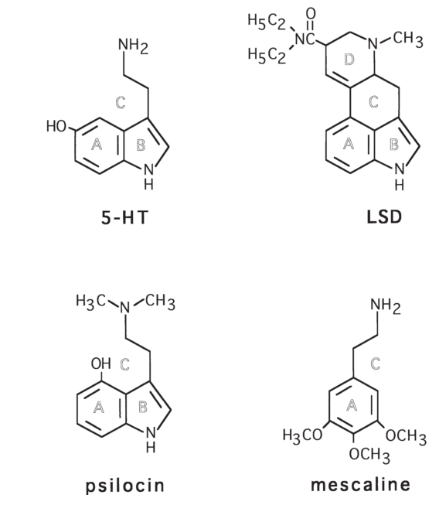
Classical hallucinogens: Structure
Glennon (1999):
  bind at 5-HT2 serotonin receptors
  recognized by animals trained to discriminate DOM from vehicle
Tryptamines/indoleamines
  Psilocybin, ayahuasca, DMT
  Ergolines
  subclass of tryptamines with a phenethylamine backbone
    high activity at dopamine receptors
    LSD
    Ergine (LSA) –morning glory
Phenethylamines
  Mescaline (peyote, San Pedro)
  DOM, DOI, DOC
Cross tolerance
(Aghajanian and Marek 1998).
Notes:
chemical structures: A, B, C, and D rings of LSD
→ indolethylamine nucleus of 5–HT and psilocin
→ phenethylamine nucleus shared by LSD and mescaline
common DOM-like stimulus effect in rats
Psilocybin is quicklyd dephosphylated into psilocin

Slide 8
Classical hallucinogens: Structure
Glennon (1999):
  bind at 5-HT2 serotonin receptors
  recognized by animals trained to discriminate DOM from vehicle
Tryptamines/indoleamines
  Psilocybin, ayahuasca, DMT
  Ergolines
  subclass of tryptamines with a phenethylamine backbone
    high activity at dopamine receptors
    LSD
    Ergine (LSA) –morning glory
Phenethylamines
  Mescaline (peyote, San Pedro)
  DOM, DOI, DOC
Cross tolerance
(Aghajanian and Marek 1998).
Notes:
chemical structures: A, B, C, and D rings of LSD
→ indolethylamine nucleus of 5–HT and psilocin
→ phenethylamine nucleus shared by LSD and mescaline
common DOM-like stimulus effect in rats
Psilocybin is quicklyd dephosphylated into psilocin

Slide 9
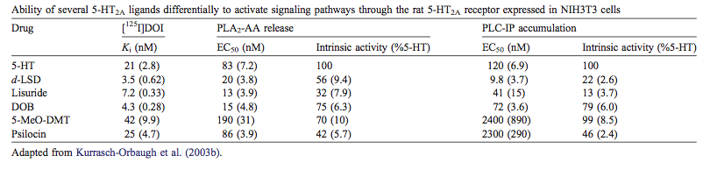
Differential signaling of 5-HT_{2a} ligands
Ability of several 5-HT_{2a} ligands to differentially activate signaling pathways
(Nichols, 2004)
Notes:
closely related chemicals (aka all binding to 5HT-2a) have similar pharmacological activity in vitro, but do not induce similar neurological effects
stimulus potencies of two dozen agents highly correlated with the reported human hallucinogenic potencies
receptor subtypes can couple to multiple signaling pathways
PLP-IP: phospholipase C-(PLC) mediated inositol phosphate (IP)
PLA2-AA: phospholipase A2-mediated arachidonic acid (AA) release
(EC50): half maximal effective concentration refers to the concentration of a drug, antibody or toxicant which induces a response halfway between the baseline and maximum after a specified exposure time
agonist trafficking of receptor signaling, although no evidence yet
→ specific agonists acting at same receptor discovered to vary in relative efficacy at activating downstream signals
→ agonists induce distinct receptor conformations ->preferentially activate specific signaling pathways
implications for understanding the mechanism of action of neuroactive chemicals
development of specific neuropharmacological therapeutics.
The behaviorally distinct effects of 5-HT2AR agonists provide a compelling experimental system for studying drug-specific signaling effects in vivo.

Slide 10
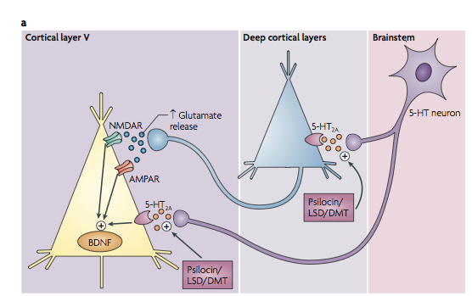
Mechanisms: Prefrontal network activation and glutamate release
(Vollenweider and Kometer, 2010)
Notes:
glutamate release
→activation of AMPA (fast synaptic transmission) and NMDA (predominant molecular device for controlling synaptic plasticity and memory function) receptors
Direct activation : Variable depolarization, hyperpolarization, or no change,
→ effects of excitatory 5-HT2 receptors or inhibitory 5-HT1A receptors are predominant in any given layer V pyramidal cell
→ coactivation of both HT2a and 1a subtypes → enhancement of responsiveness to strong excitatory stimuli little effect on weaker stimuli.

Slide 11
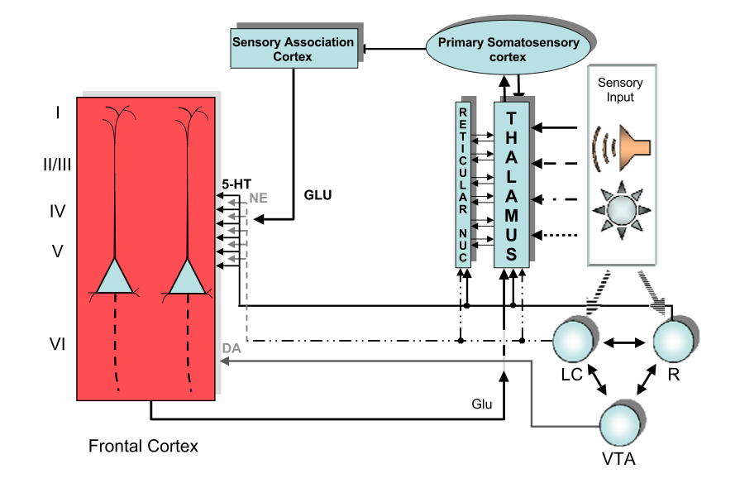
Brain area interactions of hallucinogenic agonists
(Nichols, 2004)
Notes:
possible interactions between brain areas affected by 5-HT2A agonist actions of hallucinogens (most express 5-HT2a R)
PFC: receptors localized on the proximal portion (deep layer IV/superficial layer V) of apical dendrites and dendritic spines on pyramidal cells.
R (raphe nucleus): serotonin projections to all forebrain structures (FC)
Hallucinogens reduce firing of raphe cells
stimulation of 5-HT1A receptors
Indirectly by 5-HT2A receptor activation of inhibitory GABA interneurons.
Cessation/reduction of firing --> disruption of normal serotonergic tone, which would include reduced activation of inhibitory 5-HT1A receptors on cortical pyramidal axons.
incoming sensory information processed through thalamus
modulation by the reticular nucleus of thalamus, has afferents from specific thalamic nuclei and associated cortical areas.
Both express receptors
Alterations in firing mode of thalamic neurons assoc'd with changes in neuronal responsiveness to peripheral stimuli
LC (locus coeruleus) and VTA (Ventral tegmental area)
receive input from the raphe
Hallucinogens potentiate burst firing in LC neurons in response to novel stimuli.
Systemic administration – spontaneous activity & facilitation of the activation of LC neurons by sensory stimuli
VTA cells
depolarized 5-HT2AR activation, potentially → enhanced release of DA in cortex.
significant portion of 5-HT, NE, and DA release in the cortex (may) affect neurons by volume transmission not direct synapses

Slide 12
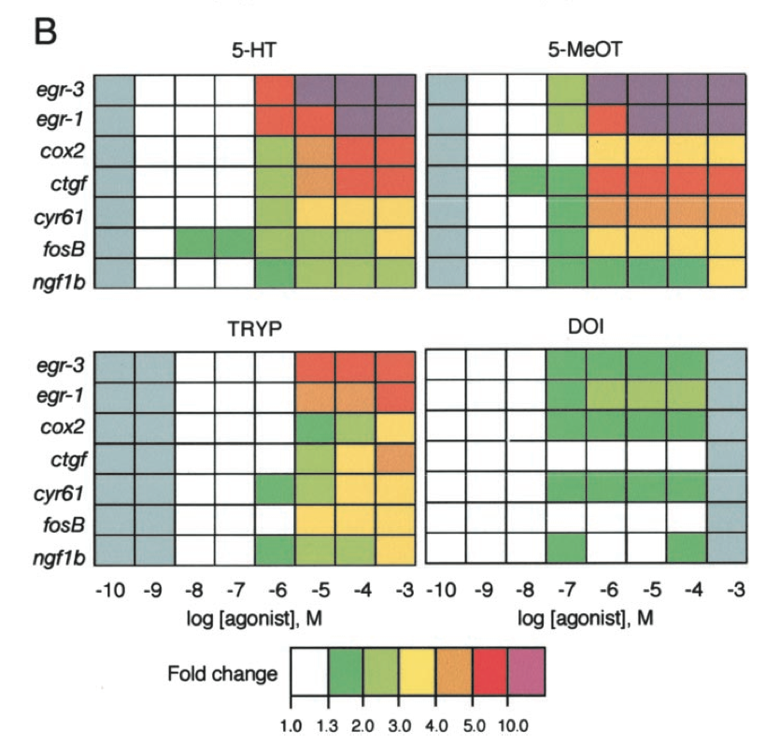
Transcriptional response to 5-HT_{2a}R agonists
Fold changes expressed relative to vehicle-treated samples.
B, transcriptome fingerprints (TFP) showing the pattern of response obtained for seven modulated transcripts. Gray indicates that agonist was not tested at that concentration.
(González-Maeso et al., 2003)
Notes:
The 5-HT2AR-expressing HEK293 cell line in rats (maybe mice?) (198A2) expresses ∼200 fmol/mg protein of human wild-type 5-HT2AR (Ebersole et al., 2003).
These are lots of growth factors
effects of psychedelics on the 5-HT_{2A} receptor are mediated through a configuration-specific pathway that is different from non-psychedelics

Slide 13
Cellular changes
Rats:
Single DOI dose transiently increased dendritic spine size in cortical neurons
repeated LSD doses downregulate 5-HT2a receptors, but not 5-HT1a
  Prefrontal cortex
  Anterior cingulate cortex (ACC)
    central role in attention
    may be important with regard to conscious & subjective emotional awareness
Notes:
Dendritic spine increase via actin cytoskeleton gene ARC which is upregulated

Slide 14
Works used heavily
Nichols, D. E. (2004). Hallucinogens. Pharmacology & Therapeutics, 101(2), 131–81. doi:10.1016/j.pharmthera.2003.11.002
Aghajanian, G. K., & Marek, G. J. (1999). Serotonin and hallucinogens. Neuropsychopharmacology, 21(2 Suppl), 16S–23S. doi:10.1016/S0893-133X(98)00135-3
González-Maeso, J., Yuen, T., Ebersole, B. J., Wurmbach, E., Lira, A., Zhou, M.,Weisstaub, N., et al. (2003). Transcriptome fingerprints distinguish hallucinogenic and nonhallucinogenic 5- hydroxytryptamine 2A receptor agonist effects in mouse somatosensory cortex. The Journal of neuroscience, 23(26), 8836–43. Retrieved from http://www.ncbi.nlm.nih.gov/pubmed/14523084
Glennon, R. A. (1999). Arylalkylamine Drugs of Abuse: An Overview of Drug Discrimination Studies, 64(2), 251–256.

Slide 15
Things I researched, but didn't talk about
Therapeutic applications
Long-term effects
fMRI and PET data
Flaws in methodologies
Research tool for consciousness
Research for schizophrenia & other psychoses
MDMA, MDA, other 'lesser' hallucinogens
cannibinoids

Slide 16

Questions?

Slide 17
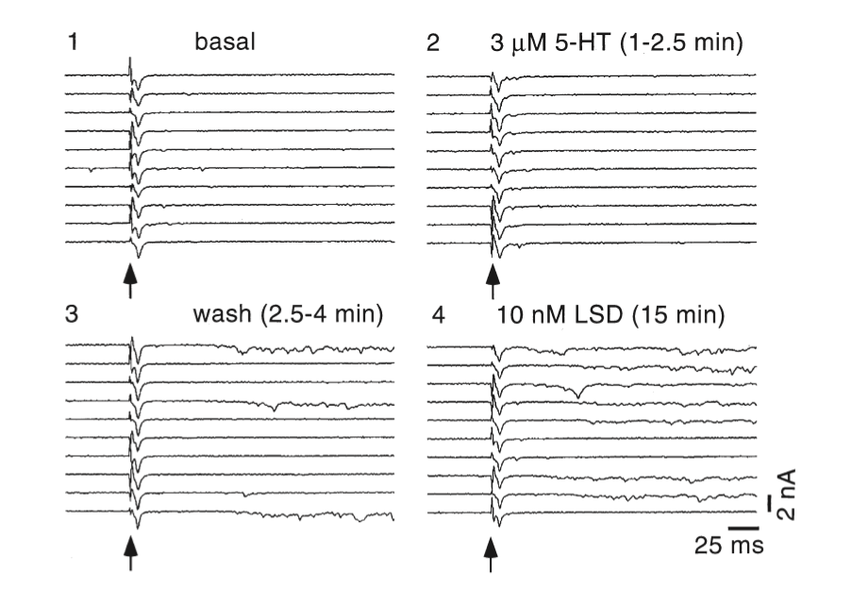
Electric changes: Excitatory post-synaptic potentials (EPSPs)
(1) responses to 10 consecutive stimuli (arrowheads)
(2) application of 5-HT → little change in anything
(3) a short washout sustained late or nonsynchronous EPSCs & recovery after an additional 10 min of wash- out
(4) a low concentration of LSD → in a large increase in the occurrence of the late, nonsynchronous component of the EPSCs
(Aghajanian and Marek 1998).
Notes:
Not shown here, but there is an increase in both frequency and amplitude of of EPSCs (excitatatory post synaptic current)
5-HT, 5-HT washout, and LSD on electrically evoked EPSCs (evEVSCs) in a layer V pyramidal cell of medial prefrontal cortex.
(1) responses to 10 consecutive stimuli (arrowheads), where only short latency synchronous EPSCs are evoked.
(2) application of 5-HT → little change in amplitude of the synchronous evoked EPSC, no increase in late components of the EPSC.
(3) After a short washout sustained late or nonsynchronous EPSCs appear after 3/10 stimuli; recovery to the basal state occurred after an additional 10 min of wash- out (not shown).
(4) Subsequent perfusion with a low concentration of LSD (10 nM) resulted in a large increase in the occurrence of the late, nonsynchronous component of the EPSCs (7/10 sweeps)

Slide 18
MRI stuff
Significant & consistent: Psilocybin significantly decreased brain blood flow and venous oxygenation in a manner correlated wit subjective effects
significantly decreased the positive coupling of two key structural hubs (the mPFC and the PCC).
More direct measures of neural activity will help inform this hypothesis, but in support of the inference that psilocybin does decrease neural activity, direct recordings of cortical local field potentials (LFPs) in rats found broadband decreases in resting state LFP power after psilocybin infusion—including γ-power (9)—changes in which are known to correlate with changes in the BOLD signal (10).
It has been commonly assumed that psychedelics work by in- creasing neural activity; however, our results put this into question. Psilocin is a mixed serotonin receptor agonist, but there is a general consensus that the characteristic subjective and behavioral effects of psychedelics are initiated via stimulation of serotonin (5-Hy- droxytryptamine, 5-HT) 2A receptors (11). It is possible that the deactivations observed in the present studies were caused by stimulation of 5-HT receptors other than 5-HT2A; There is a large body of preclinical evidence that stimulation of 5-HT2A receptors increases GABAergic transmission and pyramidal cell inhibition (14–21), which may explain the deactivations observed here (Figs. 2 and 4). fMRI studies with serotonergic compounds that stimulate other 5-HT receptors, such as the 5-HT2C (22) or (mainly) the 5-HT1A receptor (23), have not found comparable results to those shown here, and 5-HT2A receptors are present in high concentrations in the cortical regions that were significantly deactivated and decoupled after psilocybin
Notes:
A PET study found a global increase in glucose metabolism after oral psilocybin, which is inconsistent with our fMRI results.
One possible expla- nation for this discrepancy relates to the fact that the radiotracer used to measure glucose metabolism (¹⁸F-fluorodeoxyglucose) has a long half-life (110 min). Thus, the effects of psilocybin, as measured by PET, are over much greater timescales than indexed by our fMRI measures. It is therefore possible that phasic or short- term effects of psilocybin show some rebound that is detected by longer-term changes in glucose metabolism.
however, this seems unlikely given that the affinity of psychedelics for the 5- HT2A receptor correlates with their potency (12) and 5-HT2A antagonists block the subjective effects of psychedelics (13).

Slide 19
More MRI!
Stimulation of the 5-HT2A receptor increases excitation in the host cell by reducing outward potassium currents (24). Thus, if the 5-HT2A receptor did mediate the observed deactivations, then it may have been via 5-HT2A-induced excitation of fast-spiking interneurons terminating on pyramidal cells (e.g., ref. 24) or 5-HT2A-induced excitation of pyramidal cells projecting onto interneurons (25).
Regardless of how these effects were initiated at the receptor level, it is necessary for us to offer a functional explanation for them. It is noteworthy that the regions which showed the most consistent deactivations after psilocybin (e.g., the PCC and mPFC) are also those that show disproportionately high activity under normal conditions (26). For example, metabolism in the PCC is ∼20% higher than most other brain regions (27), yet psilocybin decreased its blood flow by up to 20% in some subjects. There is some mystery about the function of the PCC; its large size, buff- ered location, and rich vasculature means that it is well protected from damage. The high metabolic activity of the PCC and the default-mode network (DMN) with which is it associated (26) has led some to speculate about its functional importance, positing a role in consciousness (28) and high-level constructs, such as the self (29) or “ego” (30, 31). Indeed, the DMN is known to be ac- tivated during self-referencing (28) and other high-level functions linked to the self-construct (27). Moreover, DMN regions are also known to host the highest number of cortico-cortical connections in the brain, making them important “connector hubs” (32). These hubs may be critical for efficient information transfer in the brain by allowing communication between different regions via the fewest number of connections (33). However, such an integrative function would confer a significant responsibility on these regions, which may explain why their deactivation has such a profound effect on consciousness, as shown here.
These results may have implications beyond explaining how psilocybin works in the brain by implying that the DMN is crucial for the maintenance of cognitive integration and constraint under normal conditions. This finding is consistent with Aldous Huxley’s “reducing valve” metaphor (34) and Karl Friston’s “free-energy principle” (35), which propose that the mind/brain works to con- strain its experience of the world.

Slide 20
Levels of trippin'
Level I
mild 'stoning' effect, some visual enhancement
Some short term memory anomalies.
Level II
Bright colours and visuals (i.e. things start to move and breathe)
continual distractive thought patterns, increase in abstract thought
Level III
obvious visuals, everything looking curved and warped
mild hallucinations
synesthesia
Time distortions
Difficulty moving
Level IV
Strong hallucinations, i.e. objects morphing into other objects, and inanimate objects communicating
Destruction or multiple splittings of the ego, some loss of reality
Time becomes meaningless
Out-of-body experiences
Level V
Total loss of visual connection with reality.
Senses cease to function in any normal way
Total loss of ego and/or merging with space, other objects, or the universe.

Slide 21
Long term psychological effects aka plasticity (but this slide is also an outline)
may alter one’s concepts of reality, may change one’s views on life and death, and can provoke and challenge one’s most cherished beliefs.
But also, that article about it being a memorable experience ike 15 years after
Also like...it's clearly affecting how sensory things are processed in the short term
Excitability changes
PESPs
Also I like it because they're so heavily setting-dependent
It's like epigenetics but drug classes!
Treatment of alcoholism, PTSD – all the fun things!
Tolerances builds VERY fast—daily dosage of LSD → almost complete tolerance in 4 days
Are 5ht2a,b receptors very easily modified? Maybe because they have to do all the sensory adjustment and they're constantly changing
like if you're kept in a dark room for two days how long does it take for your eyes to readjust
Notes:
may alter one’s concepts of reality, may change one’s views on life and death, and can provoke and challenge one’s most cherished beliefs.

Slide 22
Long-term effects
“most moving spiritual experience”
OCD & anxiety treatments
Other therapeutic applications
Compared to Navajos with minimal substance use, the peyote group showed no significant deficits on the RMHI or any neuropsychological measures, whereas the former alcoholic group showed significant deficits (p 􏰇 .05) on every scale of the RMHI and on two neuropsychological measures. Within the peyote group, total lifetime peyote use was not significantly associated with neuropsychological performance.
“At 2 months, the volunteers rated the psilocybin experience as having substantial personal meaning and spiritual significance and attributed to the experience sus- tained positive changes in attitudes and behavior consistent with changes rated by community observers.” (R. R. Griffiths, 2006)

Slide 23
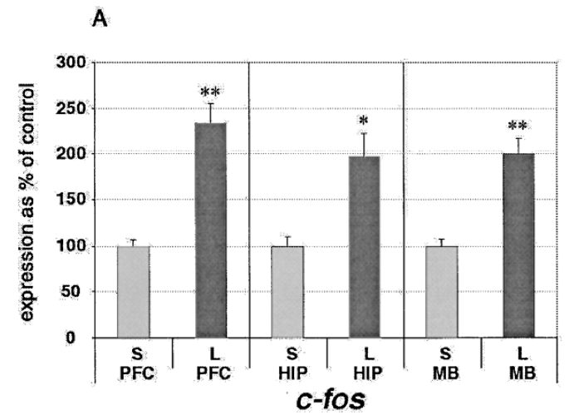
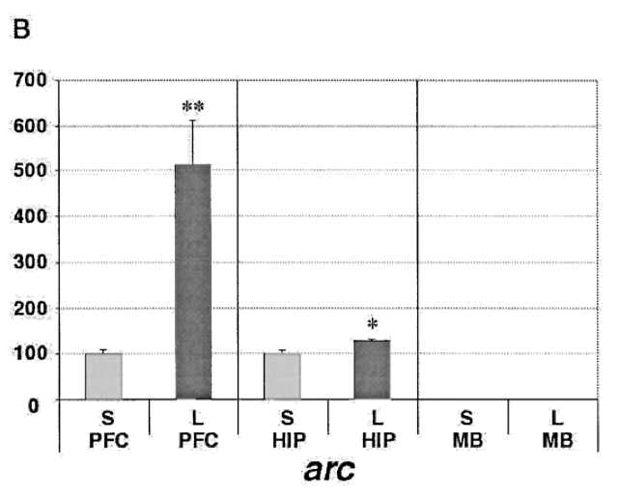
Figure 3. Expression of immediate early genes c-fos and arc.
(A) Acute LSD induces the expression of c-fos ~twofold in all regions of the brain examined.
(B) Acute LSD induces arc expression ~fivefold in the prefrontal cortex, but doesn’t dramati- cally alter levels in the hippocampus. Arc expression is not detected in the midbrain.
L: LSD treated, S: control
C.D. Nichols and E. Sanders Bush, 2002.
Notes:
Significance calculated by Students t-test (* p ? .05; ** p ? .01).
ARC

Slide 24
4.3.4. Functional consequences of serotonin2A receptor activation in prefrontal cortex
Studies on isolated PFC slice don't capture all the effcts of hallucinogens
Raphe nuclei are 5-HT afferents in the PFC, but are cut by slice preparations
Adrenergic LC-->cortex input
Destruction of thalamus ↔ cortex
In medial PFC, direct DOI → marked increase in extracellular 5-HT, where systematically it leads to decreased extracellular 5-Ht
Good for direct effects on cell excitability & cortico-cortico interactions
Early studies of layer II pyramidal cells in piriform cortex: activation of 5-HT2A receptors increased spontaneous IPSPs through activation of GABAergic layer III interneurons
effect antagonized by low concentrations selective 5-HT2A receptor antagonist
These interneurons served as a useful model system because they appear to express no other 5-HT receptor subtypes, whereas PFC pyramidal cells have both 5-HT1A and 5-HT2A receptors (Araneda & Andrade, 1991).
hallucinogens were 5-HT2A agonists, partial agonists, or antagonists. In that study, both LSD and DOI, at physiologically relevant concentrations, induced concentration-dependent increases in the firing rate of these interneurons. The maximal increases produced by 10 nM LSD and 1 AM DOI were about 30% and 50%, respectively. Pretreatment with 1 AM DOI did not antago- nize the excitatory effect of subsequently applied 5-HT (100 AM), and 10 nM LSD pretreatment only reduced the 100 AM 5-HT response by about 14%. These data showed that LSD and DOI were potent partial agonists at 5-HT2A receptors in piriform cortical interneurons, providing evi- dence for the hypothesis that hallucinogens were agonists rather than antagonists.
neocortex focal application of 5-HT to mPFC pyramidal cells leads to two distinct physiological responses (Davies et al., 1987).
In rat PFC neurons, 5-HT induces excitatory postsynaptic potentials (EPSPs), with the most marked effect being an increase in the frequency of spontaneous EPSCs (Aghaja- nian & Marek, 1997). The effect was concentration depen- dent with an EC50 of about 20 AM. The 5-HT2A antagonist M100907 produced a rightward shift in the dose-response curve and the response was sensitive to Ca²⁺ levels and

Slide 25
PERSONAL OUTLINE
Cultural and historical
Dis associative, deliriants
We mean hallucingons! With these classic symptoms!
Phenethylamines vs. indoleamines, chemical structure
Molecular basis
Brain area basis
What the upregulated genes do
Signaling pathways
  Intracellular cascades
  G coupled proteins
Less frequent, but higher amplitude—external neuronal signalling
fMRI/PET stuff (dampens connections in XYZ dimensions)
Brain areas:
  Claustrum
  Locus couerulus
  Prefrontal cortex
Genes
  Arc
  EGR1 early growth response 1
  c-fos

